Slide 1
Contain Your Enthusiasm
Docker in a day

Slide 2
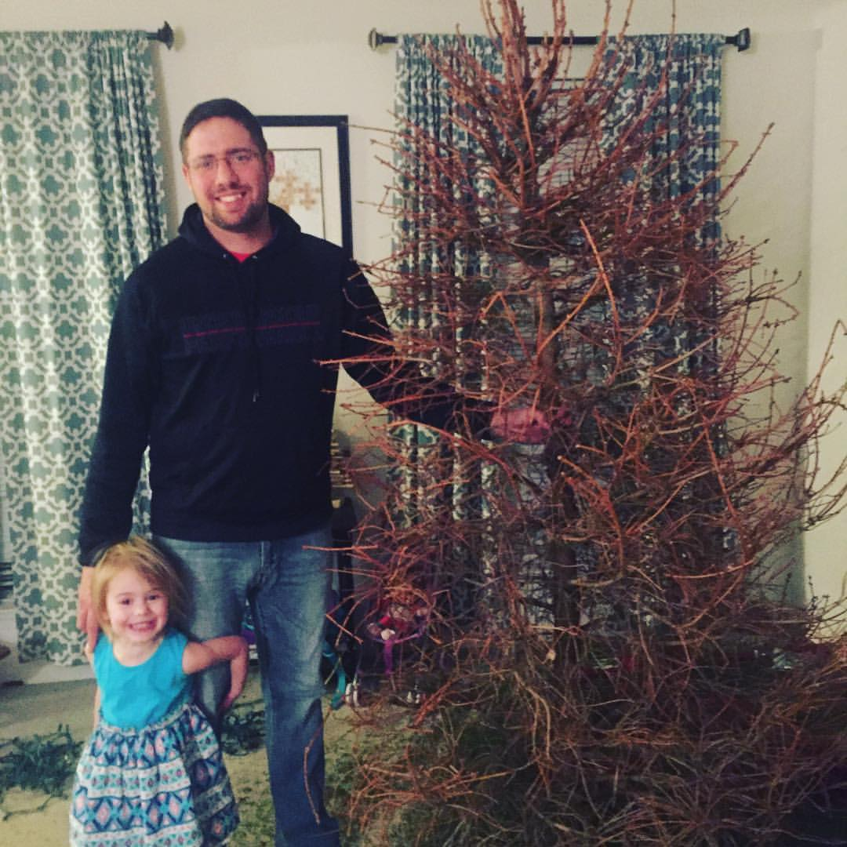

Jason L. van Brackel
Solutions Architect
@jasonvanbrackel
@k8sPhilly

Slide 3
A Brief History of Containers
Before Docker

Slide 4
A Brief History of Containers
Chaning the root directory of a process and all of its children to a new location in the filesystem
The beginning of process isolation
1979: Unix V7
chroot Introduced
A Brief History of Containers: From 1970s chroot to Docker 2016 - http://blog.aquasec.com/a-brief-history-of-containers-from-1970s-chroot-to-docker-2016

Slide 5
A Brief History of Containers
FreeBSD Jails allows administrators to partition a FreeBSD computer system into several independent, smaller systems – called “jails” – with the ability to assign an IP address for each system and configuration.
2000: FreeBSD
Jails
A Brief History of Containers: From 1970s chroot to Docker 2016 - http://blog.aquasec.com/a-brief-history-of-containers-from-1970s-chroot-to-docker-2016

Slide 6
A Brief History of Containers
FreeBSD Jails allows administrators to partition a FreeBSD computer system into several independent, smaller systems – called “jails” – with the ability to assign an IP address for each system and configuration.
2001: FreeBSD
Jails
A Brief History of Containers: From 1970s chroot to Docker 2016 - http://blog.aquasec.com/a-brief-history-of-containers-from-1970s-chroot-to-docker-2016

Slide 7
A Brief History of Containers
Linux VServer is a jail mechanism that can partition resources (file systems, network addresses, memory)
Introduced in 2001, this operating system virtualization that is implemented by patching the Linux kernel.
Experimental patches are still available, but the last stable patch was released in 2006
2001: Linux VServer
A Brief History of Containers: From 1970s chroot to Docker 2016 - http://blog.aquasec.com/a-brief-history-of-containers-from-1970s-chroot-to-docker-2016

Slide 8
A Brief History of Containers
Oracle released a Solaris Container that combines system resource controls and boundary separation provided by zones, which were able to leverage features like snapshots and cloning from ZFS.
The ZFS name originally stood for "Zettabyte File System
In 2005, the bulk of Solaris, including ZFS, was licensed as open-source software under the Common Development and Distribution License (CDDL), as the OpenSolaris project.
Became a standard feature in Solaris 10
2004: Oracle Solaris Containers
A Brief History of Containers: From 1970s chroot to Docker 2016 - http://blog.aquasec.com/a-brief-history-of-containers-from-1970s-chroot-to-docker-2016

Slide 9
A Brief History of Containers
This is an operating system-level virtualization technology for Linux which uses a patched Linux kernel for virtualization, isolation, resource management and checkpointing.
The code was not released as part of the official Linux kernel.
2005: OpenVZ (Open Virtuzzo)
A Brief History of Containers: From 1970s chroot to Docker 2016 - http://blog.aquasec.com/a-brief-history-of-containers-from-1970s-chroot-to-docker-2016

Slide 10
A Brief History of Containers
Google project designed to limit, account for and isolate resource usage
Later renamed to cgroups. Merged into the Linux kernel at 2.6.24 (24 Jan 2008)
2006: Process Containers
A Brief History of Containers: From 1970s chroot to Docker 2016 - http://blog.aquasec.com/a-brief-history-of-containers-from-1970s-chroot-to-docker-2016

Slide 11
A Brief History of Containers
LXC (LinuX Containers) was the first, most complete implementation of Linux container manager.
Implemented in 2008 using cgroups and Linux namespaces,
Linux kernel without requiring any patches.
2008: LXC
A Brief History of Containers: From 1970s chroot to Docker 2016 - http://blog.aquasec.com/a-brief-history-of-containers-from-1970s-chroot-to-docker-2016

Slide 12
A Brief History of Containers
Built by CloudFoundry
Their own version of LxC
Isolates environments on any operating system, running as a daemon and providing an API for container management.
Developed a client-server model to manage a collection of containers across multiple hosts
Includes a service to manage cgroups, namespaces and process life cycle.
2011: Warden
A Brief History of Containers: From 1970s chroot to Docker 2016 - http://blog.aquasec.com/a-brief-history-of-containers-from-1970s-chroot-to-docker-2016

Slide 13
A Brief History of Containers
Let Me Contain That For You (LMCTFY) Open-Source version of Google's container stack, providing Linux application containers.
Applications can be made “container aware,” creating and managing their own subcontainers.
Active deployment in LMCTFY stopped in 2015 after Google started contributing core LMCTFY concepts to libcontainer.
Which is now part of the Open Container Foundation.
2013: LMCTFY
A Brief History of Containers: From 1970s chroot to Docker 2016 - http://blog.aquasec.com/a-brief-history-of-containers-from-1970s-chroot-to-docker-2016

Slide 14
Virtualization and Container Concepts

Slide 15
Virtualization
Virtual Memory
Application Virtualization (JIT / JVM)
Hardware Virtualization (VMWare / Hyper-V)
Containers (OS Virtualization)

Slide 16
Containers – OS Virtualization
Local Disk looks like a pristine copy of the OS
Memory appears consistent with a freshly booted OS

Slide 17
Containers are not VMs
VM
Containers
App A
App A₁
App B
Windows Server Guest OS
Windows Server Guest OS
Windows Server Guest OS
App A
App A₁
App A₂
App A₃
App B
App B₁
Docker
Hypervisor (Type 2)
Windows Server (Host OS)
Windows Server (Host OS)
Server
Server

Slide 18
Containers are not VMs
VM
Containers
App A
App A₁
App B
Windows Server Guest OS
Windows Server Guest OS
Windows Server Guest OS
App A
App A₁
App A₂
App A₃
App B
App B₁
Docker
Hypervisor (Type 1)
Windows Server (Host OS)
Server
Server

Slide 19
Containers are not VMs
VM
Containers
App A
App A₁
App B
App A
App A₁
App A₂
App A₃
App B
App B₁
Docker
App A
App A₁
App A₂
App A₃
App B
App B₁
Docker
App A
App A₁
App A₂
App A₃
App B
App B₁
Docker
Windows Server Guest OS
Windows Server Guest OS
Windows Server Guest OS
Windows Server (Host OS)
Windows Server (Host OS)
Windows Server (Host OS)
Hypervisor (Type 1)
Hypervisor (Type 1)
Server
Server

Slide 20
Containers are not VMs
VMs
Containers
Hardware Virtualization
OS Isolation
Full Copy of the OS
Hypervisor responsible for maintaining isolation
OS Virtualization
Userspace and Namespace Isolation
Enough of the OS for the Application to use
Docker Daemon responsible for maintaining isolation

Slide 21
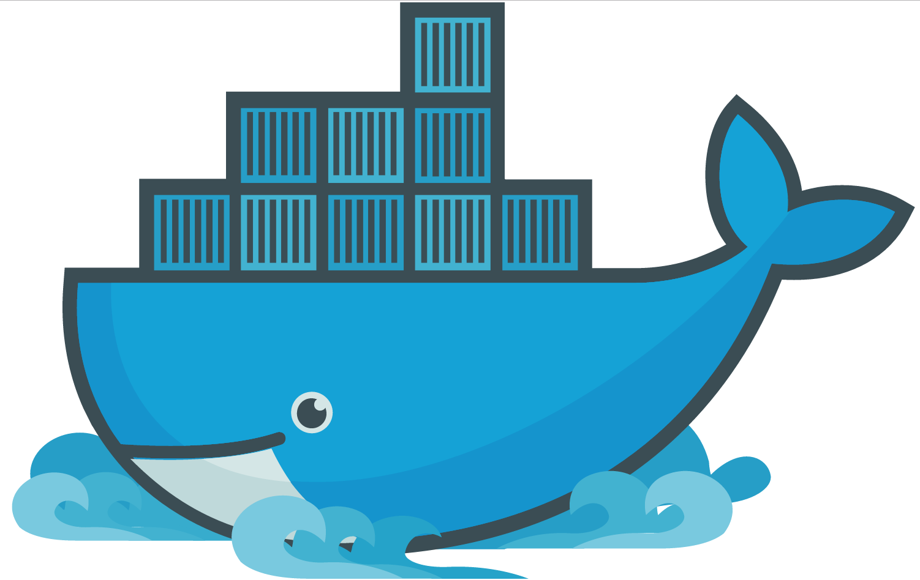
Docker

Slide 22
Docker
A company
A suite of tools for building, deploying and managing applications using Docker containers
An container engine

Slide 23
Docker Engine
It runs docker images
docker
dockerd

Slide 24
Docker Toolbox
A virtualized development environment to create docker images in Windows and Mac OSX
Backed by VirtualBox
Conflicts with Hyper-V
Conflicts with Docker for Windows

Slide 25
Docker Machine
Install and run Docker on Mac or Windows
Provision and manage multiple remote Docker hosts
Provision Swarm clusters

Slide 26
Docker Compose
Tool for defining and running multi-container Docker applications
Define your app’s environment with a Dockerfile
Define services that make up your app in docker-compose.yml
Run

Slide 27
Docker Swarm
Prior to version 1.12
Docker Swarm is native clustering for Docker
Turns a pool of Docker hosts into a single, virtual Docker host
Uses the standard Docker API, any tool that already communicates with a Docker daemon can use Swarm to transparently scale to multiple hosts
Functionality folded into Docker in 1.12
Swarm mode

Slide 28
Docker Container Fundamentals

Slide 29
Docker Container Fundamentals
dockerd
thin layer between containers and the kernel
Docker Daemon

Slide 30
Docker Container Fundamentals
Developer user dockerfiles to build container images
Dockerfile

Slide 31
Dockerfile
FROM microsoft/iis
RUN mkdir C:\site
RUN powershell -NoProfile -Command \
Import-module IISAdministration; \
New-IISSite -Name "Site" -PhysicalPath C:\site -BindingInformation "*:8000:“
ADD content/ /site

Slide 32
# Pull base image.
FROM dockerfile/ubuntu
# Install Nginx.
RUN \
add-apt-repository -y ppa:nginx/stable && \
apt-get update && \
apt-get install -y nginx && \
rm -rf /var/lib/apt/lists/* && \
echo "\ndaemon off;" >> /etc/nginx/nginx.conf && \
chown -R www-data:www-data /var/lib/nginx
# Define mountable directories.
VOLUME ["/etc/nginx/sites-enabled", "/etc/nginx/certs", "/etc/nginx/conf.d", "/var/log/nginx", "/var/www/html"]
# Define working directory.
WORKDIR /etc/nginx
# Define default command.
CMD ["nginx"]
# Expose ports.
EXPOSE 80
EXPOSE 443

Slide 33
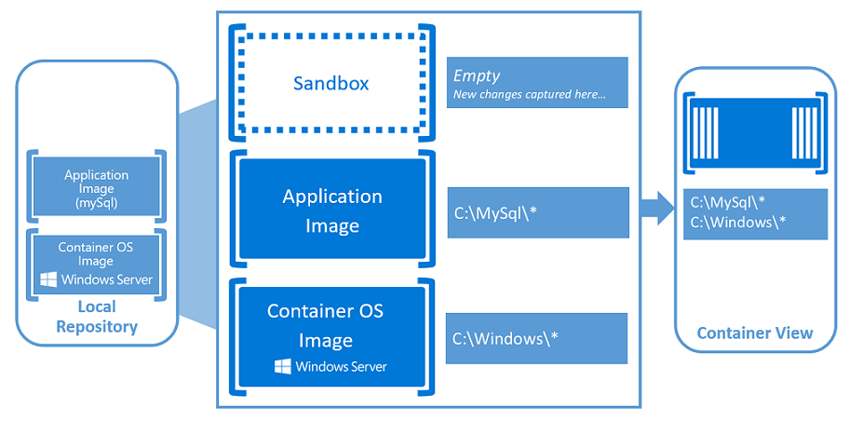
Container Fundamentals
Windows Containers - https://docs.microsoft.com/en-us/virtualization/windowscontainers/about/index

Slide 34
Docker Container Fundamentals
Container Images are Published and Stored here
Docker Hub is a public cloud-based container registry managed by Docker
Registry

Slide 35
Docker Architecture

Slide 36
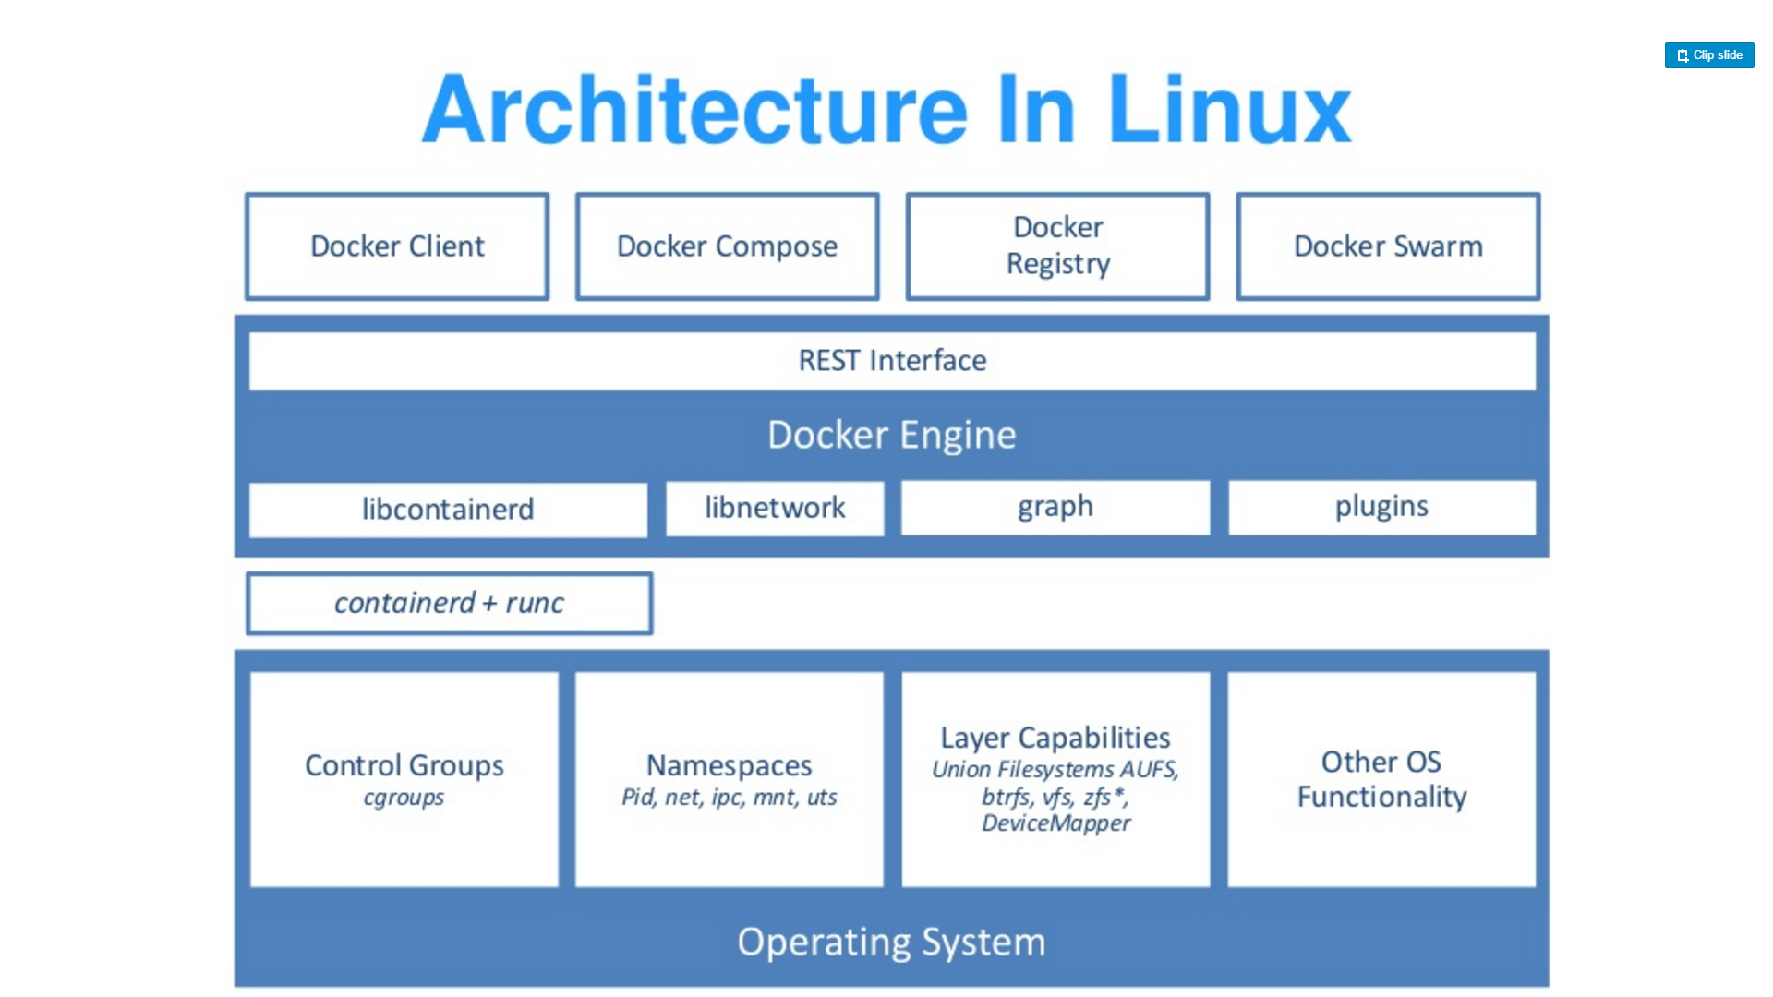
Source: “DockerCon 16: Windows Server & Docker - The Internals Behind Bringing Docker & Containers to Windows - Black Belt”

Slide 37
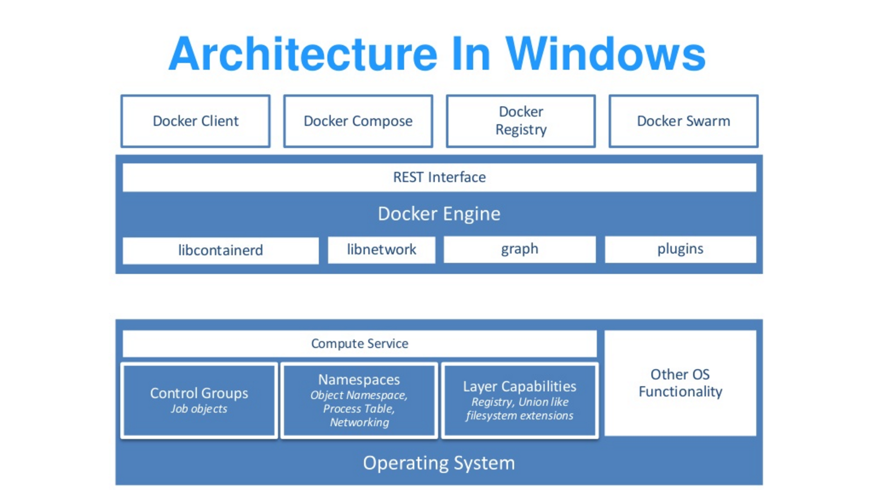
Source: “DockerCon 16: Windows Server & Docker - The Internals Behind Bringing Docker & Containers to Windows - Black Belt”

Slide 38
Docker Architecture
Docker library written in Go.
Cross-Platform Unix / Solaris / Linux / Windows
https://github.com/docker/docker/tree/master/libcontainerd
Uses underlying OS fundamentals to create containers
libcontainerd

Slide 39
Docker Architecture
Simple daemon that uses runC to manage containers
Containerd uses gRPC to expose a CRUD interface around containers
Docker Engine expands this, but also images, volumes, networks, builds, etc. using a full-blown HTTP API
runc + containerd

Slide 40
Docker Architecture
Public interface to manage running containers
Replaces containerd for Windows
Abstracts low-level kernel capabilities
https://blogs.technet.microsoft.com/virtualization/2017/01/27/introducing-the-host-compute-service-hcs/
Compute Service
Source: “DockerCon 16: Windows Server & Docker - The Internals Behind Bringing Docker & Containers to Windows - Black Belt”

Slide 41
Docker Architecture
Part of the Win32 API
Allows a group of processes to be managed as a single object
https://msdn.microsoft.com/en-us/library/windows/desktop/ms684161(v=vs.85).aspx
Job Objects
Source: “DockerCon 16: Windows Server & Docker - The Internals Behind Bringing Docker & Containers to Windows - Black Belt”

Slide 42
Docker Architecture
Extends the Job Object
New Namespace Virtualization
Registry
Process ID
Object Namespace
File system
Network Compartments
Namespaces (Silo)
Source: “DockerCon 16: Windows Server & Docker - The Internals Behind Bringing Docker & Containers to Windows - Black Belt”

Slide 43
Docker Architecture
Kernel view of the world
\DosDevices\C:\Windows
\Registry
\Device\Tcp
\Device\Null
Similar concept to chroot
\Silo\foo\DosDevices\C:\Windows
\Silo\bar\DosDevices\C:\Windows
Object Namespaces
Source: “DockerCon 16: Windows Server & Docker - The Internals Behind Bringing Docker & Containers to Windows - Black Belt”

Slide 44
Docker Architecture
Windows Applications expect NTFS semantics
Building an union FS with NTFS semantics is hard
Hybrid Model
NTFS partitions per container
Symlinks to layers on the host file system
File system
Source: “DockerCon 16: Windows Server & Docker - The Internals Behind Bringing Docker & Containers to Windows - Black Belt”

Slide 45
Docker Architecture
Small file system
True union FS
Windows Registry
Source: “DockerCon 16: Windows Server & Docker - The Internals Behind Bringing Docker & Containers to Windows - Black Belt”

Slide 46
Docker Architecture
Docker uses Unionfs to layer Docker images.
As actions are done to a base image, layers are created and documented, such that each layer fully describes how to recreate an action.
This strategy enables Docker's lightweight images, as only layer updates need to be propagated.
UnionFS
Source: https://en.wikipedia.org/wiki/UnionFS

Slide 47
Container Types
Linux Containers
Docker Containers
Rocket Containers
Windows Containers
Windows Server Containers
Hyper-V Containers (Default)

Slide 48
Container Types
Docker Image Format
https://github.com/docker/docker/blob/master/image/spec/v1.md
OCI Image Specification
https://github.com/opencontainers/image-spec
Main differences are how they approach security
Container Image Security
Preventing root escalation attacks
Portability
Linux
Source: https://en.wikipedia.org/wiki/UnionFS

Slide 49
Container Types
Rocket Image Format
https://github.com/docker/docker/blob/master/image/spec/v1.md
Rocket
Source: https://en.wikipedia.org/wiki/UnionFS

Slide 50
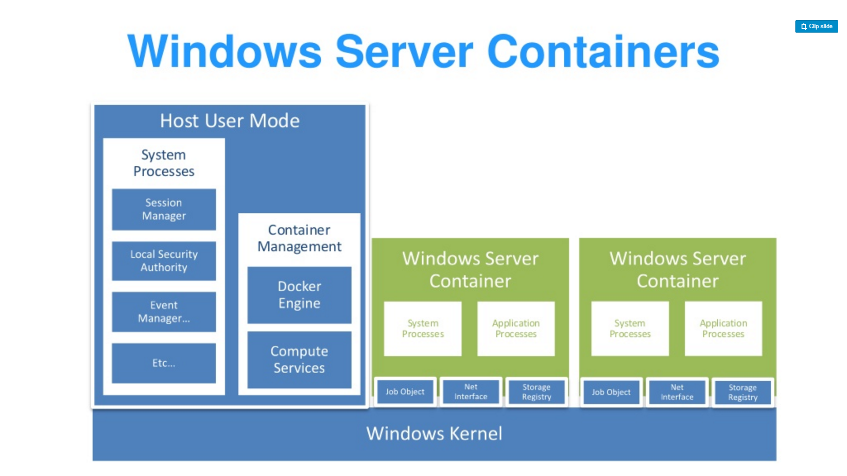
Source: “DockerCon 16: Windows Server & Docker - The Internals Behind Bringing Docker & Containers to Windows - Black Belt”

Slide 51
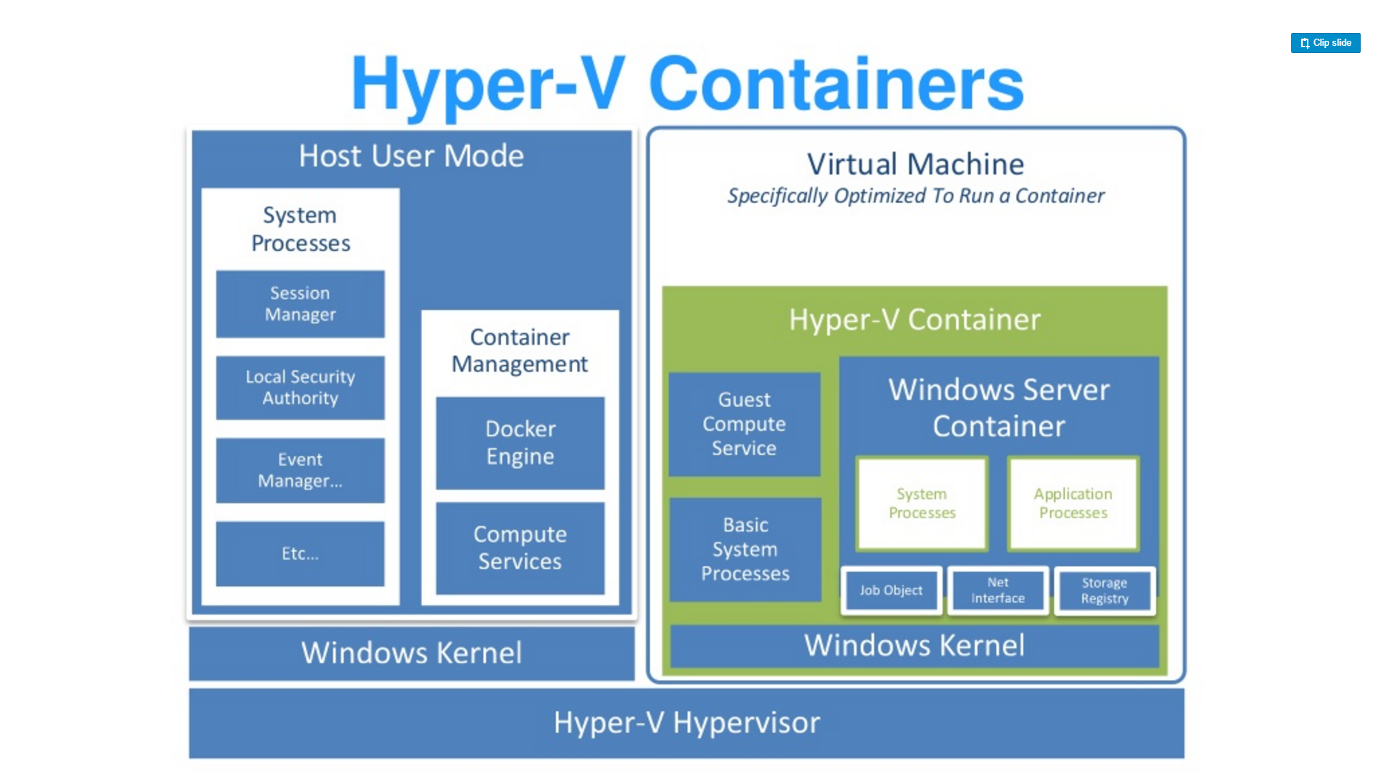
Source: “DockerCon 16: Windows Server & Docker - The Internals Behind Bringing Docker & Containers to Windows - Black Belt”

Slide 52
Container Types
Default in Windows 10
Small, stateless VM
Writes are not persisted
Storage attached via SMB
Over VMBus not networking
Physically map executables from the host file cache
Networking is a virtual nic
Cloning
Launch utility VM
Freeze State
Fork the VM for each new instance
No startup time
Shares memory
Hyper-V Container
Source: https://en.wikipedia.org/wiki/UnionFS

Slide 53
More Information on Architecture
DockerCon 16: Windows Server & Docker - The Internals Behind Bringing Docker & Containers to Windows - Black Belt
https://channel9.msdn.com/Blogs/containers/DockerCon-16-Windows-Server-Docker-The-Internals-Behind-Bringing-Docker-Containers-to-Windows

Slide 54
Exercise 1
Creating a Windows Server 2016 VM

Slide 55
Exercise 1
Create an Azure Account
Create an Windows Server 2016 VM with Containers
Create a NanoServer VM
Create a Windows Server Core VM
Create a Windows Server Container
Create a Hyper-V Container
Explore the Windows Container VMs
Creating a Windows Server 2016 VM and Getting Familiar with Docker

Slide 56
Dockerfile and Docker Compose

Slide 57
Dockerfile
FROM microsoft/iis
RUN mkdir C:\site
RUN powershell -NoProfile -Command \
Import-module IISAdministration; \
New-IISSite -Name "Site" -PhysicalPath C:\site -BindingInformation "*:8000:“
ADD content/ /site

Slide 58
Dockerfile
Containers should be ephemeral
Consistent with Processes section of 12 factor application methodology
General guildelines

Slide 59
Dockerfile
Avoid installing unnecessary packages
Reduces complexity
Reduces dependencies
Reduces files sizes
Reduces build times
General guildelines

Slide 60
Dockerfile
Each container should do 1 thing
Containers that depend on one another should be netoworked
Not one process per container
General guildelines

Slide 61
Dockerfile
Sort multi-line arguments
Easier to read and maintain
RUN apt-get update && apt-get install -y \
bzr \
cvs \
git \
mercurial \
subversion
General guildelines

Slide 62
Dockerfile instructions
FROM
Sets the base image
FROM <image>
FROM <image>:<tag>
FROM

Slide 63
Dockerfile instructions
RUN
Executes the command on the current image and commits the results
RUN <command>
/bin/sh –c
cmd /S /C
RUN [“executable”, “param1”, “param2”]
RUN

Slide 64
Dockerfile instructions
https://github.com/docker/compose/releases/download/1.11.1/
CMD
There can be only one per Dockerfile
The main purpose is to provide defaults for an executing container.
CMD ["executable","param1","param2"]
CMD

Slide 65
Dockerfile instructions
EXPOSE
Informs the Docker engine that the container listens to this port at run time.
EXPOSE <port> [<port>...]
EXPOSE

Slide 66
Dockerfile instructions
ENV
Sets an environment variable in the container
ENV key value ENV key=value
ENV

Slide 67
Dockerfile instructions
ADD
Copies files from the developer’s system to the container’s file system.
ADD <src>... <dest>
ADD ["<src>",... "<dest>"] (this form is required for paths containing whitespace)
ADD

Slide 68
Dockerfile instructions
COPY
Copies files from the developer’s system to the container’s file system.
COPY <src>... <dest>
COPY ["<src>",... "<dest>"] (this form is required for paths containing whitespace)
COPY

Slide 69
Dockerfile instructions
ENTRYPOINT
An ENTRYPOINT allows you to configure a container that will run as an executable
FROM ubuntu
ENTRYPOINT ["top", "-b"]
CMD ["-c"]
FROM debian:stable
RUN apt-get update && apt-get install -y --force-yes apache2
EXPOSE 80 443
VOLUME ["/var/www", "/var/log/apache2", "/etc/apache2"]
ENTRYPOINT ["/usr/sbin/apache2ctl", "-D", "FOREGROUND"]
ENTRYPOINT

Slide 70
Dockerfile instructions
VOLUME
The VOLUME instruction creates a mount point with the specified name and marks it as holding externally mounted volumes from native host or other containers.
FROM ubuntu
RUN mkdir /myvol
RUN echo "hello world" > /myvol/greeting
VOLUME /myvol
docker run -v /Users/<path>:/<container path> docker run -v //c/<path>:/<container path>
VOLUME

Slide 71
Dockerfile instructions
USER
The USER instruction sets the user name or UID to use when running the image and for any RUN, CMD and ENTRYPOINT instructions that follow it in the Dockerfile.
USER

Slide 72
Dockerfile instructions
WORKDIR
The WORKDIR instruction sets the working directory for any RUN, CMD, ENTRYPOINT, COPY and ADD instructions that follow it in the Dockerfile. If the WORKDIR doesn’t exist, it will be created even if it’s not used in any subsequent Dockerfile instruction.
WORKDIR /a
WORKDIR b
WORKDIR c
RUN pwd
WORKDIR

Slide 73
Dockerfile instructions
ARG
The ARG instruction defines a variable that users can pass at build-time to the builder with the docker build command using the --build-arg <varname>=<value>
ARG <name>[=<default value>]
ARG

Slide 74
Dockerfile instructions
ONBUILD
The ONBUILD instruction adds to the image a trigger instruction to be executed at a later time, when the image is used as the base for another build. The trigger will be executed in the context of the downstream build, as if it had been inserted immediately after the FROM instruction in the downstream Dockerfile.
ONBUILD [INSTRUCTION]
ONBUILD

Slide 75
Dockerfile instructions
HEALTHCHECK
The HEALTHCHECK instruction tells Docker how to test a container to check that it is still working.
New as of Docker 1.12
HEALTHCHECK --interval=5m --timeout=3s \
CMD curl -f http://localhost/ || exit 1
HEALTHCHECK

Slide 76
Dockerfile instructions
SHELL
The SHELL instruction allows the default shell used for the shell form of commands to be overridden. The default shell on Linux is ["/bin/sh", "-c"], and on Windows is ["cmd", "/S", "/C"].
SHELL ["powershell", "-command"]
RUN Write-Host hello
SHELL

Slide 77
Dockerfile examples

Slide 78
# Nginx
#
# VERSION 0.0.1
FROM ubuntu
LABEL Description="This image is used to start the foobar executable" Vendor="ACME Products" Version="1.0"
RUN apt-get update && apt-get install -y inotify-tools nginx apache2 openssh-server

Slide 79
# Firefox over VNC
#
# VERSION 0.3
FROM ubuntu
# Install vnc, xvfb in order to create a 'fake' display and firefox
RUN apt-get update && apt-get install -y x11vnc xvfb firefox
RUN mkdir ~/.vnc
# Setup a password
RUN x11vnc -storepasswd 1234 ~/.vnc/passwd
# Autostart firefox (might not be the best way, but it does the trick)
RUN bash -c 'echo "firefox" >> /.bashrc'
EXPOSE 5900
CMD ["x11vnc", "-forever", "-usepw", "-create"]

Slide 80
# Firefox over VNC
#
# VERSION 0.3
FROM ubuntu
# Install vnc, xvfb in order to create a 'fake' display and firefox
RUN apt-get update && apt-get install -y x11vnc xvfb firefox
RUN mkdir ~/.vnc
# Setup a password
RUN x11vnc -storepasswd 1234 ~/.vnc/passwd
# Autostart firefox (might not be the best way, but it does the trick)
RUN bash -c 'echo "firefox" >> /.bashrc'
EXPOSE 5900
CMD ["x11vnc", "-forever", "-usepw", "-create"]

Slide 81
# MongoDB
FROM microsoft/windowsservercore
ENV MONGO_VERSION=3.4.1
COPY build /
RUN mkdir C:\data\db & setx /m PATH %PATH%;C:\mongodb\bin
VOLUME C:\\data\\db
EXPOSE 27017
CMD ["mongod.exe"]

Slide 82
#NodeJS
FROM microsoft/windowsservercore
SHELL ["powershell", "-Command", "$ErrorActionPreference = 'Stop'; $ProgressPreference = 'SilentlyContinue';"]
ENV NPM_CONFIG_LOGLEVEL info
ENV NODE_VERSION 7.6.0
ENV NODE_SHA256 9cc8fd129483aa64557155842dc8f1e7ed288efeab1a7fbb0210314bc7213058
RUN Invoke-WebRequest $('https://nodejs.org/dist/v{0}/node-v{0}-win-x64.zip' -f $env:NODE_VERSION) -OutFile 'node.zip' -UseBasicParsing ; \
if ((Get-FileHash node.zip -Algorithm sha256).Hash -ne $env:NODE_SHA256) {exit 1} ; \
Expand-Archive node.zip -DestinationPath C:\ ; \
Rename-Item -Path $('C:\node-v{0}-win-x64' -f $env:NODE_VERSION) -NewName 'C:\nodejs' ; \
New-Item $($env:APPDATA + '\npm') ; \
$env:PATH = 'C:\nodejs;{0}\npm;{1}' -f $env:APPDATA, $env:PATH ; \
[Environment]::SetEnvironmentVariable('PATH', $env:PATH, [EnvironmentVariableTarget]::Machine) ; \
Remove-Item -Path node.zip
CMD [ "node.exe" ]

Slide 83
Docker Compose
Tool for defining and running multi-container Docker applications
Define your app’s environment with a Dockerfile
Define services that make up your app in docker-compose.yml
Run

Slide 84
Docker Compose
The Compose file is a YAML file defining services, networks and volumes
Default path is ./docker-compose.yaml

Slide 85
Docker Compose
YAML
YAML A’int Markup Language
http://yaml.org/
YAML

Slide 86
Docker Compose
Service configuration refrence
https://docs.docker.com/compose/compose-file/#/service-configuration-reference
Services

Slide 87
Docker Compose
Network configuration refrence
https://docs.docker.com/compose/compose-file/#/network-configuration-reference
Networks

Slide 88
Docker Compose
Volumes configuration refrence
https://docs.docker.com/compose/compose-file/#/volume-configuration-reference
Volumes

Slide 89
Exercise 2
Multi-container Applications in Docker

Slide 90
Exercise 2
Get Docker Compose on Windows Server
Clone an ASP.NET MVC App and Review the code
Review the Docker Compose file
Run the code
Multi-container Applications in Docker

Slide 91
Exercise 3
Let’s Get Competitive

Slide 92
Exercise 3 Competition
You have 90 minutes
Create something fun and useful
Must build and run
Winner gets a RaspberryPi 2 with Wi-Pi

Slide 93
Microservices Architecture
Building modern scalable applications

Slide 94
Microservices Architecture
Emerging design pattern componentizing business services into small decomposable parts
Best understood when compared to Monoliths

Slide 95
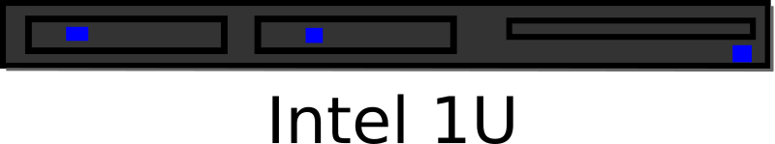
Monoliths
UI
Business Logic
Database

Slide 96

Monoliths
UI
Business Logic
Database

Slide 97


Monoliths

Slide 98
Monoliths - Patterns
N-Tier
Service Oriented Architectures (SOA )
Enterprise Service Bus (ESB)

Slide 99




Monoliths - Technology
Virtual Machines
Infrastructure as a Service (IaaS)
Platform as a Service (PaaS)
Infrastructure Automation

Slide 100
Monoliths - Pros and Cons
Pros
Cons
Mature
Easy to Monitor
Optimization
Stateful
Consistent
Transactional
Troubleshooting
Scale Performance
Maintenance Costs
Siloed Teams

Slide 101
Monoliths – Conway’s Law
Any organization that designs a system (defined broadly) will produce a design whose structure is a copy of the organization's communication structure.
-- Melvyn Conway, 1967

Slide 102
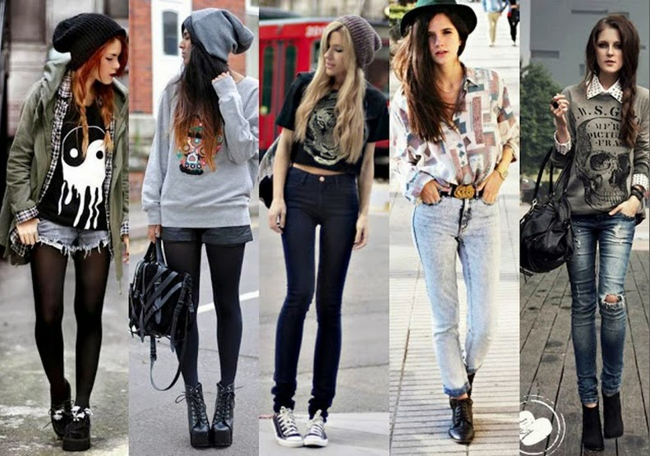
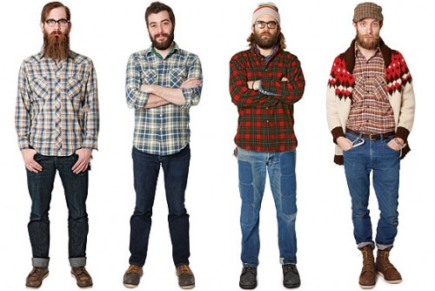

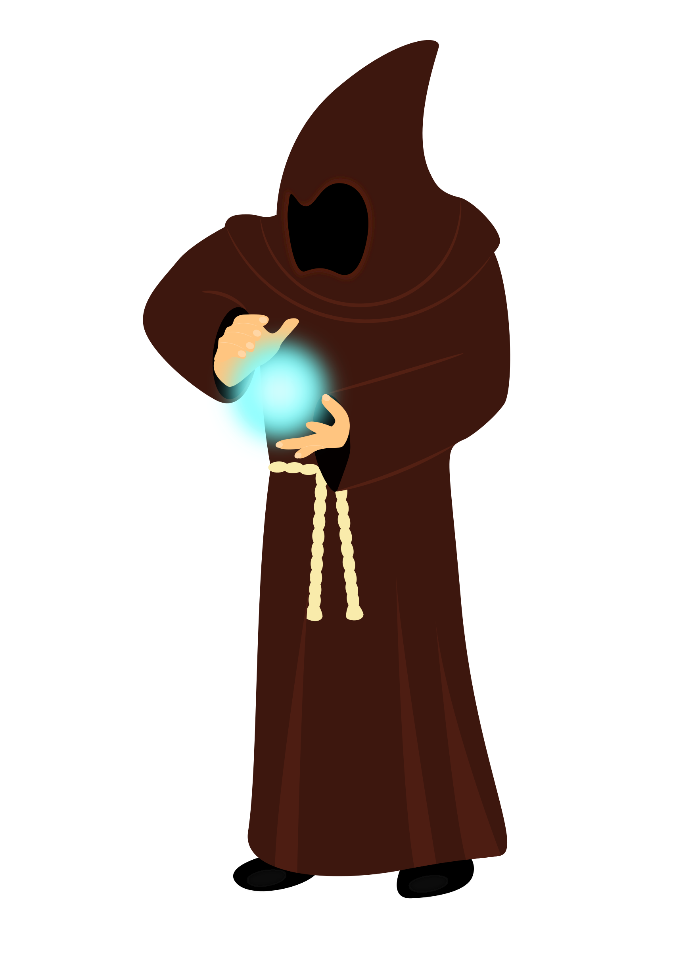

Monoliths – Conway’s Law

Slide 103
Microservices
Focused Around Business Services
Cross Functional Teams
Commodity Hardware

Slide 104
Monoliths – Conway’s Law
Any organization that designs a system (defined broadly) will produce a design whose structure is a copy of the organization's communication structure.
-- Melvyn Conway, 1967

Slide 105


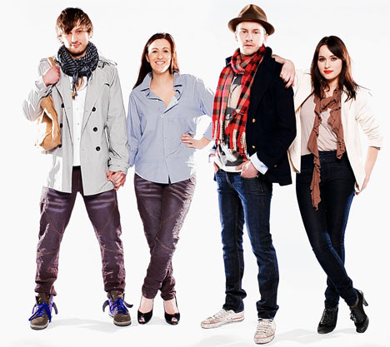
Microservices – Conway’s Law
Two Pizza Team
6 – 12 People
Cross-functional Teams

Slide 106
Microservices
SPA
Smaller Services
Running in their own processes
Ephemeral
Products vs. Projects
Smart Endpoints
Dumb Pipes
Decentralized Governance
Decentralized Data management

Slide 107
Microservices - Pros and Cons
Pros
Cons
Simple Functionally
Performance
Scale
Independent Deployment
Fast Deployment
Cross-functional teams
Self Organizing
Self Governing
Technology Diversity
Difficult Operationally
Immature
Distribution
Difficult introspection
Stateless
Eventually Consistent
Troubleshooting

Slide 108


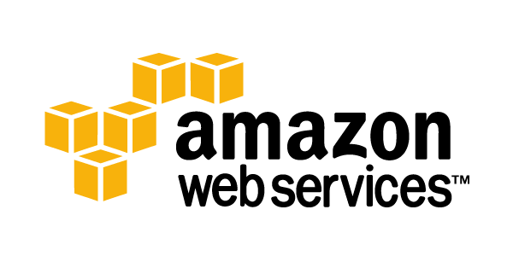
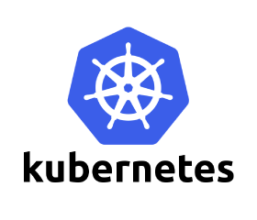

Microservices - Technology
Container as a Service(CaaS)
Platform as a Service (PaaS)
Container Automation

Slide 109



Microservices - Technology
Logging
Monitoring

Slide 110
Microservices - Patterns
Service Brokers
UI – Driven Applications
SPA
Message Driven Applications
Evolution not Revolution

Slide 111
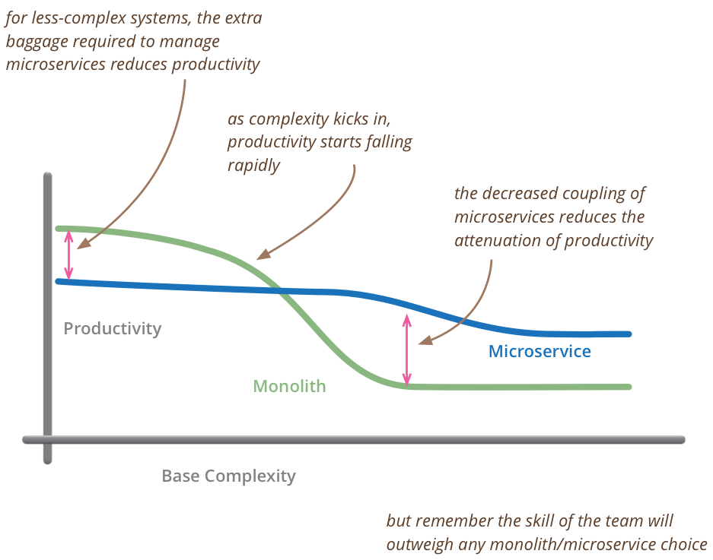
Microservices Premium
Source: http://www.martinfowler.com/bliki/MicroservicePremium.html

Slide 112
The 12 Factors
A modern app methodology for building applications

Slide 113
The 12 Factors
Created by the Heroku PaaS team as they created SaaS Apps
Can be applied to any language and combination of technologies.

Slide 114
The 12 Factors
I. Codebase
One codebase tracked in revision control, many deploys
II. Dependencies
Explicitly declare and isolate dependencies
III. Config
Store config in the environment
IV. Backing services
Treat backing services as attached resources
V. Build, release, run
Strictly separate build and run stages
VI. Processes
Execute the app as one or more stateless processes

Slide 115
The 12 Factors
VII. Port binding
Export services via port binding
VIII. Concurrency
Scale out via the process model
IX. Disposability
Maximize robustness with fast startup and graceful shutdown
X. Dev/prod parity
Keep development, staging, and production as similar as possible
XI. Logs
Treat logs as event streams
XII. Admin processes
Run admin/management tasks as one-off processes

Slide 116
Walkthrough
Applying the 12 Factors to Docker

Slide 117
Container Orchestration
Making containers enterprise ready with Kubernetes

Slide 118
Key Trends
Monolithic < Distributed
SOA < Micro Services
VMs < Containers
Closed < Open
Static < Dynamic
Centralization < Decentralization
Where we’ve been headed for the last decade, that’s lead us here

Slide 119
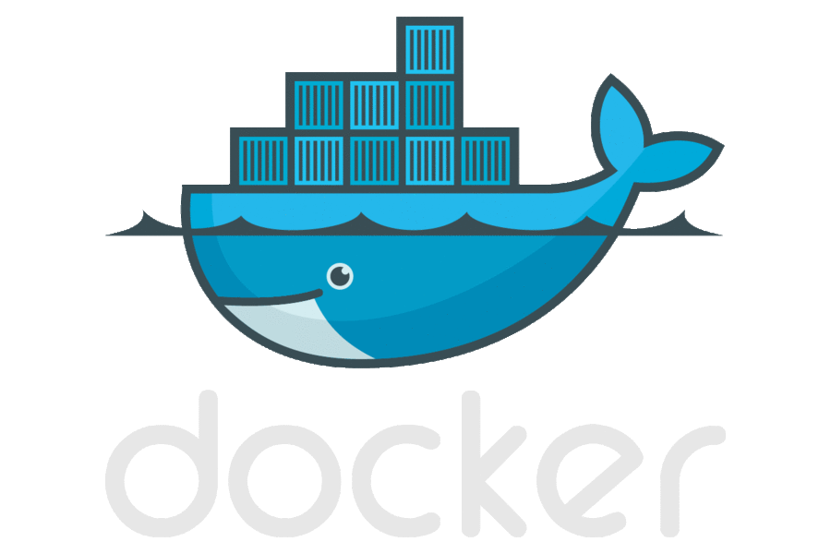
Why Containers?
Performance
Repeatability
Isolation
Density
Quality of service
Accounting
Visibility
Portability

Slide 120

Doug Cutting
Co-creator of Lucene, Nutch & Hadoop
“Google is living years in the future, sending the rest of us messages!”

Slide 121
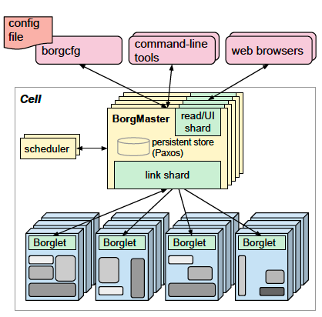
Kubernetes Lineage Google Borg
Runs hundreds of thousands of jobs..
..for many thousands of different applications (YouTube, Search Index, Maps, etc.)..
..across a number of clusters (hundreds)..
..each with up to tens of thousands of machines..
Borg currently manages many millions of physical servers hosting billions of containers!
In production since 2003!
Offers a declarative job specification language, name service integration, real-time job monitoring, and tools to analyze and simulate system behavior.
Source: Large-scale cluster management at Google with Borg

Slide 122
Borg Lessons Learned
Some Borg features are cautionary tales, informing alternatives in Kubernetes...
The Bad
Jobs” are restrictive as the only grouping mechanism for tasks.
No first-class way to manage an entire multi-job service as a single entity, or to refer to related instances of a service (e.g., canary and production tracks).
Complex name parsing mechanisms as hacks.
Inflexible semantics as a consequence.
Resulting Kubernetes Construct
Labels! Highly flexible; enable multiple powerful levels of decoupling.
Sources: Borg, Omega, and Kubernetes Lessons learned from three container-management systems over a decade , Burns Et Al. ,System Evolution, ACM Queue Vol. 14, Iss. 1 & Apprenda K8S Training

Slide 123
Borg Lessons Learned
Some Borg features are cautionary tales, informing alternatives in Kubernetes...
The Bad
One IP address per machine complicates things!
Borg tasks all use the single IP address of their host, and share host’s port space… Issues:
Borg must schedule ports as a resource;
tasks must pre-declare how many ports they need, and be willing to be told which ones to use when they start;
the Borglet must enforce port isolation; and the naming;
RPC systems must handle ports as well as IP addresses…
Resulting Kubernetes Construct
Unique, routable IP per Pod! Let the user choose ports; user friendly; no port mgmt.
Sources: Borg, Omega, and Kubernetes Lessons learned from three container-management systems over a decade , Burns Et Al. ,System Evolution, ACM Queue Vol. 14, Iss. 1 & Apprenda K8S Training

Slide 124
Borg Lessons Learned
Some Borg features have stood the test of time!
The Good
Allocs are useful!
A Borg alloc (short for allocation) is a reserved set of resources on a machine in which one or more tasks can be run.
Enables helper services / co-scheduled tasks (containers).
Resulting Kubernetes Construct
The K8s equivalent for allocs are Pods!
Sources: Borg, Omega, and Kubernetes Lessons learned from three container-management systems over a decade , Burns Et Al. ,System Evolution, ACM Queue Vol. 14, Iss. 1 & Apprenda K8S Training

Slide 125
Borg Lessons Learned
Some Borg features have stood the test of time!
The Good
Cluster management is more than task management...
Applications that run on Borg benefit from many other cluster services, including naming and load balancing.
Resulting Kubernetes Construct
Services! Inter/cross-cluster VIPs that dynamically attach to Pods based on Label Selectors.
Sources: Borg, Omega, and Kubernetes Lessons learned from three container-management systems over a decade , Burns Et Al. ,System Evolution, ACM Queue Vol. 14, Iss. 1 & Apprenda K8S Training

Slide 126
Borg Lessons Learned
Some Borg features have stood the test of time!
The Good
Introspection is vital.
Borg surfaces debugging information to all users rather than hiding it: Borg has thousands of users, so “self-help” has to be the first step in debugging.
Several levels of UI and debugging tools are available so users can quickly identify anomalous events related to their jobs, and then drill down to detailed event and error logs from their applications and the infrastructure itself.
Resulting Kubernetes Construct
Many introspection techniques such as cAdvisor / Fluentd / ElasticSearch
Sources: Borg, Omega, and Kubernetes Lessons learned from three container-management systems over a decade , Burns Et Al. ,System Evolution, ACM Queue Vol. 14, Iss. 1 & Apprenda K8S Training

Slide 127
We have containers. Now What?
Isolation: Keep jobs from interfering with each other
Scheduling: Where should my job be run?
Lifecycle: Keep my job running
Discovery: Where is my job now?
Constituency: Who is part of my job?
Scale-up: Making my jobs bigger or smaller
Auth{n,z}: Who can do things to my job?
Monitoring: What’s happening with my job?
Health: How is my job feeling?

Slide 128
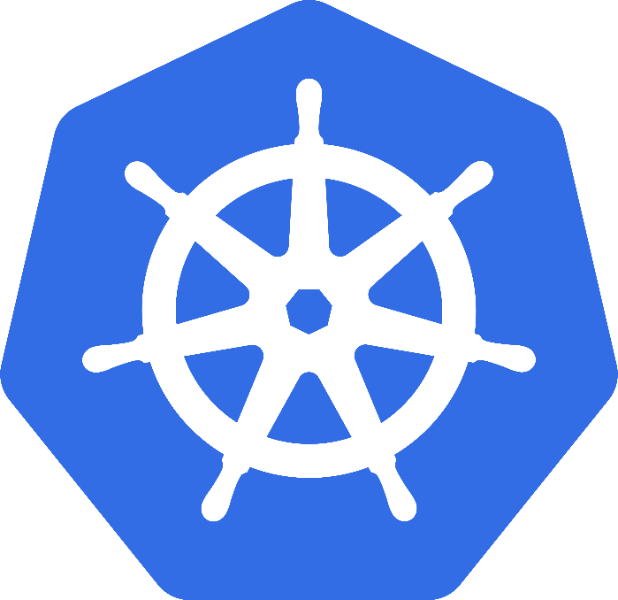
Evolution: Kubernetes
Greek for “Helmsman”; also the root of the word “Governor”
Google’s 3rd Container Platform (Borg, Omega)
Set of compossable building blocks
Container orchestrator
Runs Docker / Rkt / Linux containers / Windows Containers
Supports multiple cloud and bare-metal environments
Built on lessons learned from Borg and Omega
Written in Go
Manage applications, not machines
*Kubernetes Currently in Alpha see SIG-Windows
Notes:
Omega: Raw State Omega: Multiple Schedulers, Compossable building blocks

Slide 129
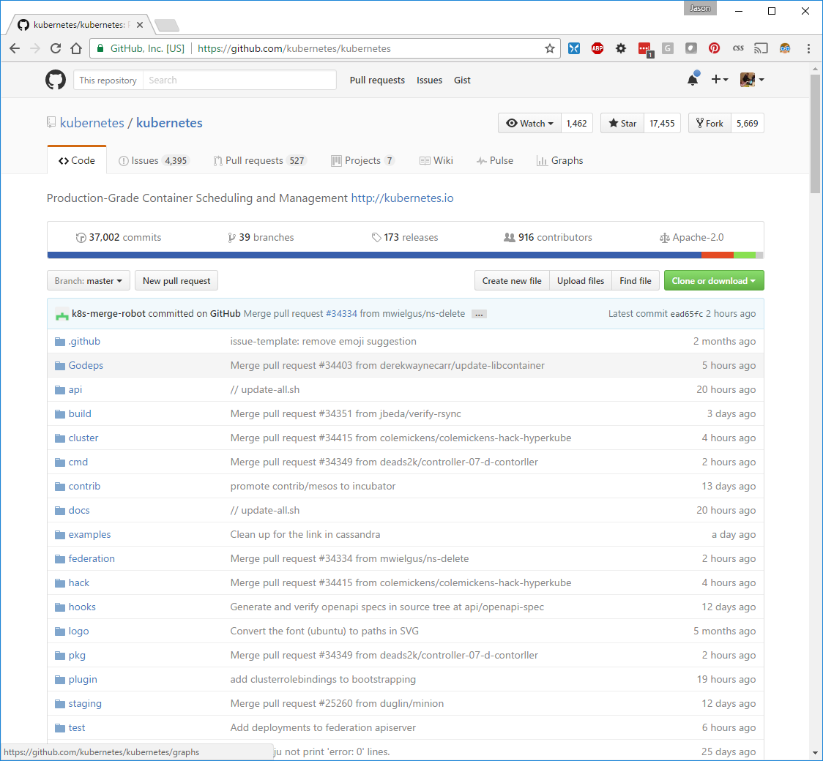

Slide 130
Key Concepts
Container: An application package (Docker / Rocket)
Pod: A small group of tightly coupled Containers
Controller: A loop that drives current state towards desired state
Service: A set of running pods that work together
Labels: Identifying metadata attached to other objects
Selector: A query against labels, producing a set result

Slide 131
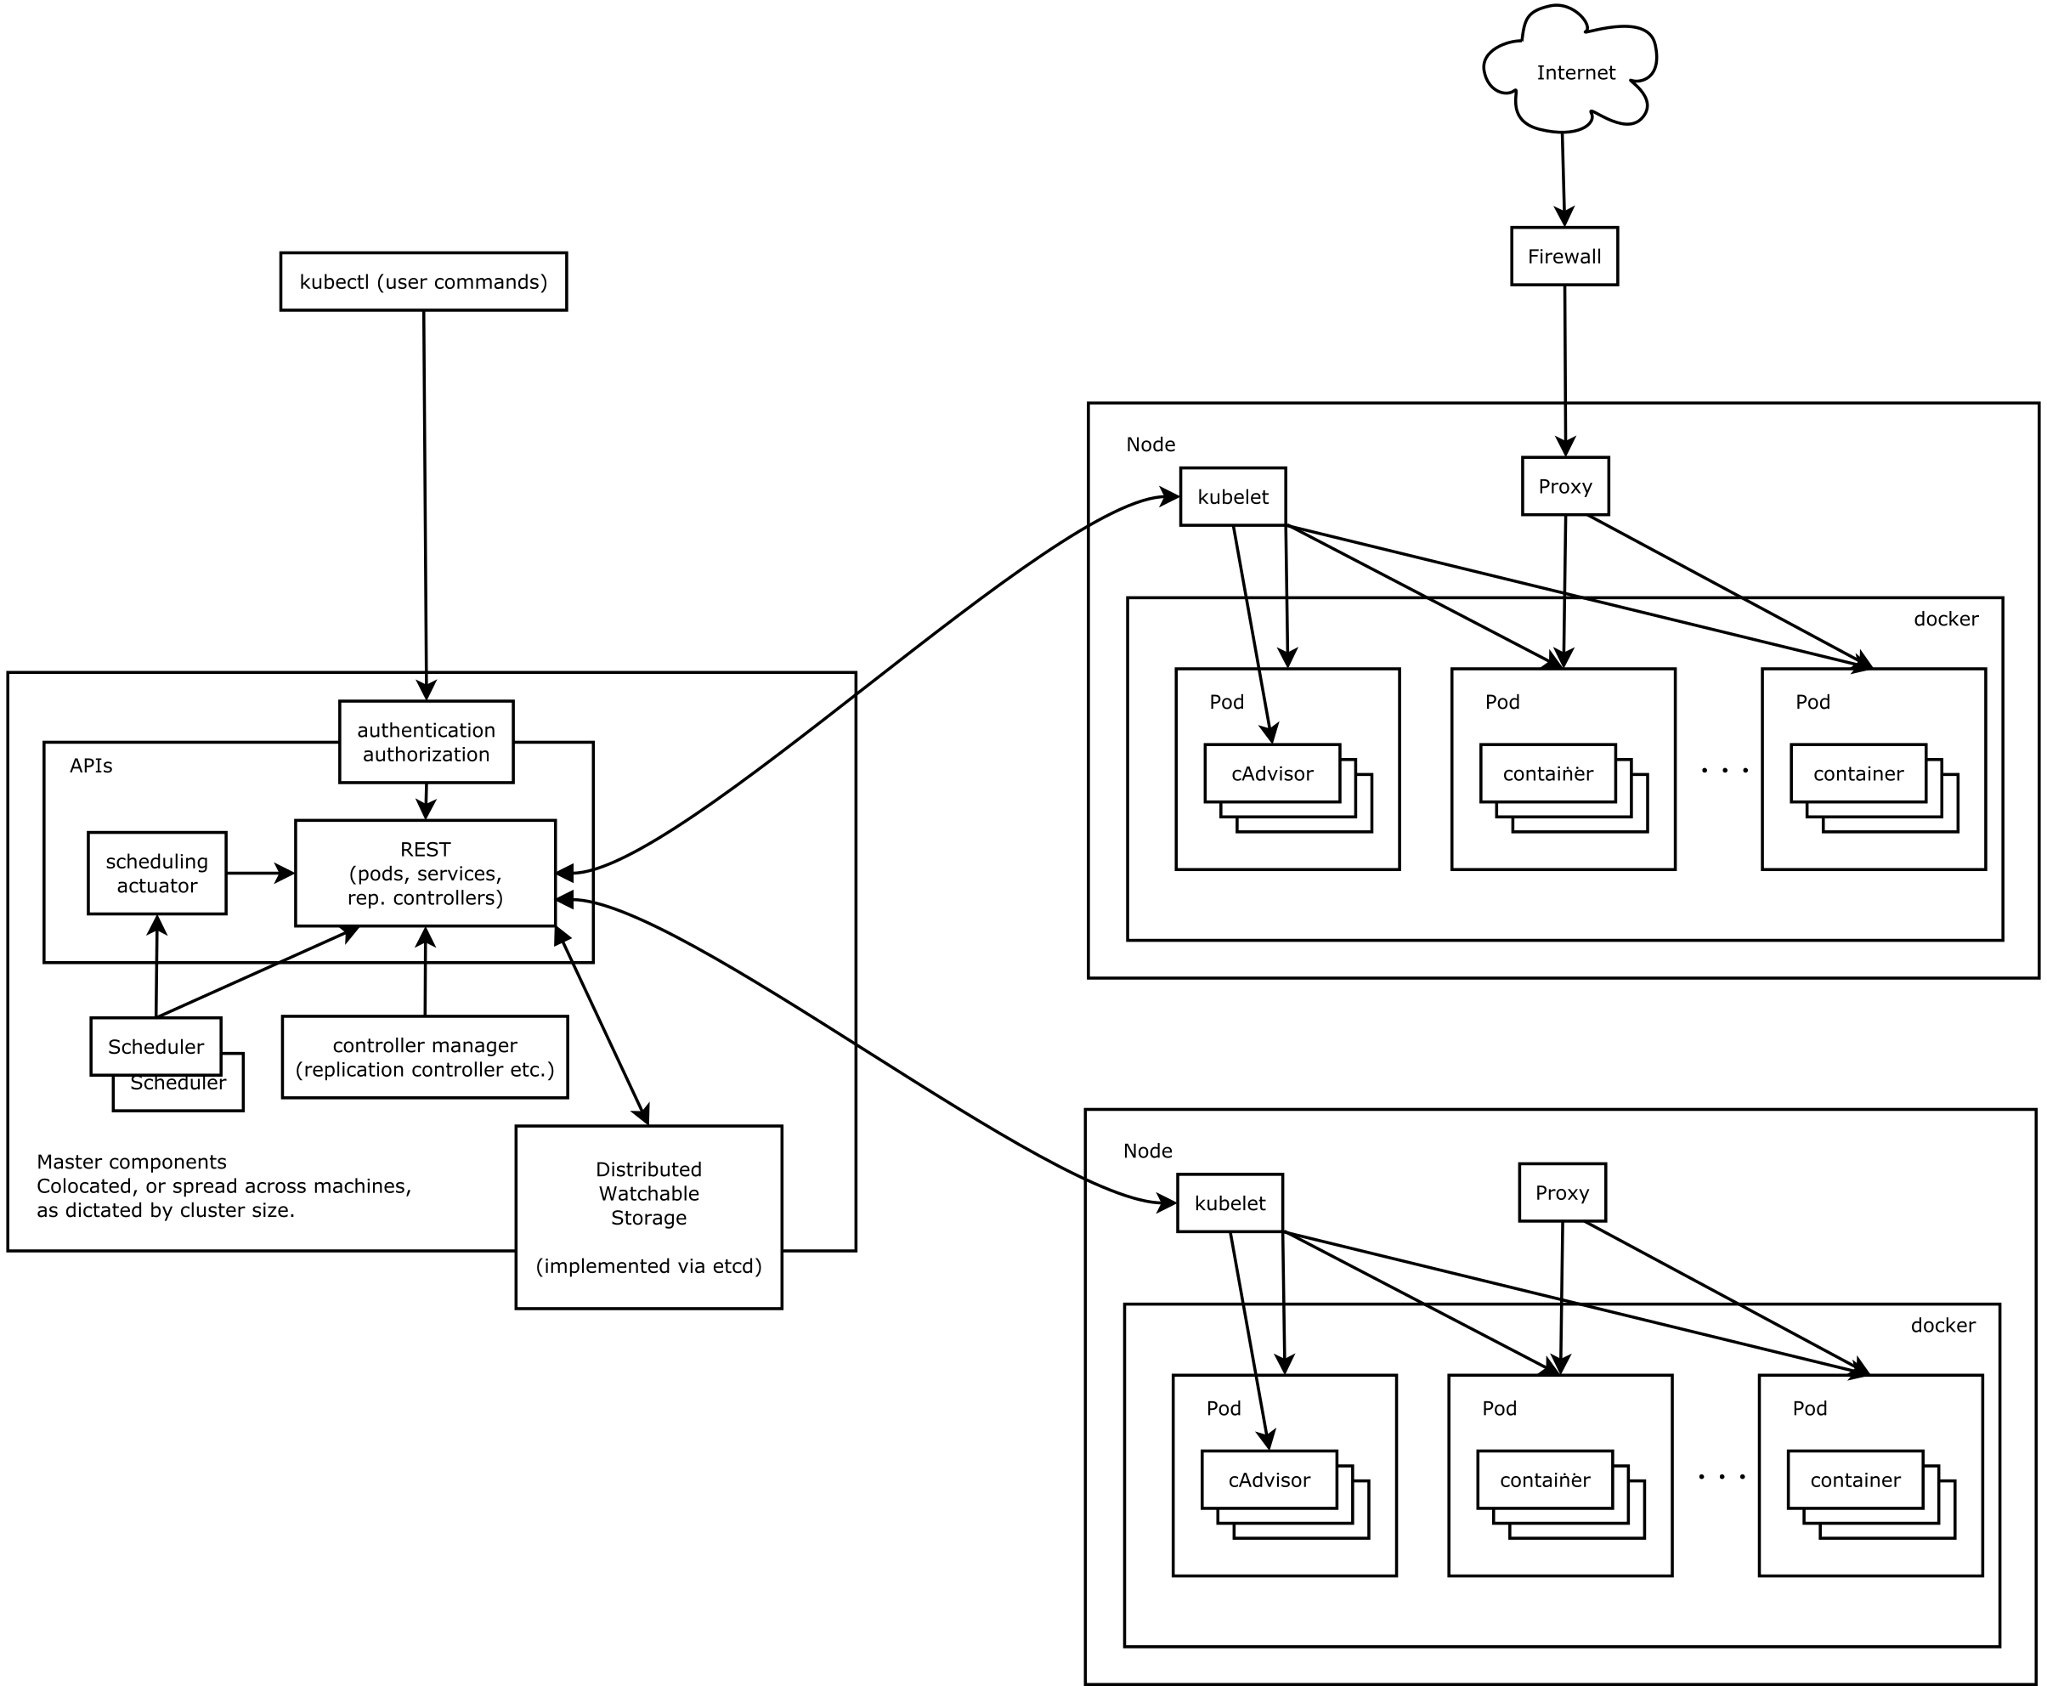
Architecture
Source: https://github.com/kubernetes/kubernetes/blob/release-1.4/docs/design/architecture.md

Slide 132
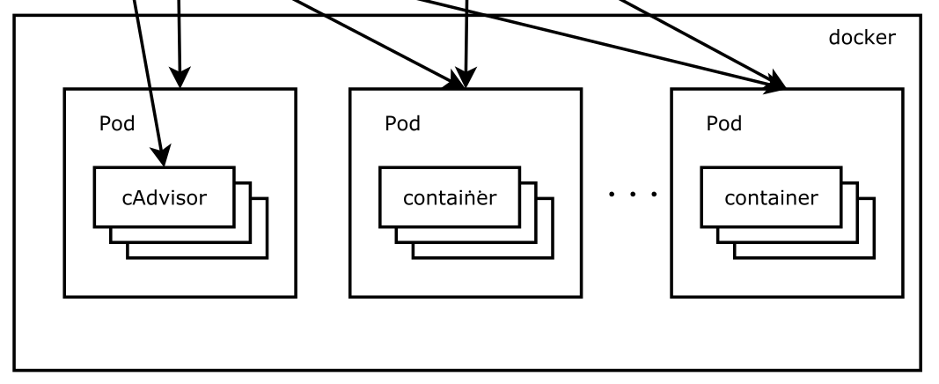
Pods
Source: https://github.com/kubernetes/kubernetes/blob/release-1.4/docs/design/architecture.md

Slide 133
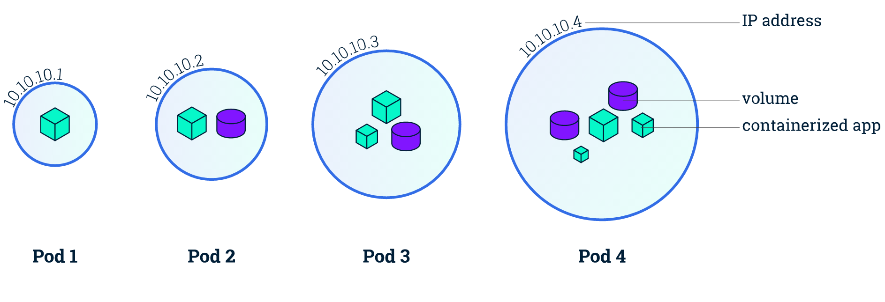
Pods
Small group of containers & volumes
Tightly coupled
Always on the same node
Atomic unit of cluster scheduling & placement
Shared namespace, IP and localhost
Ephemeral

Slide 134
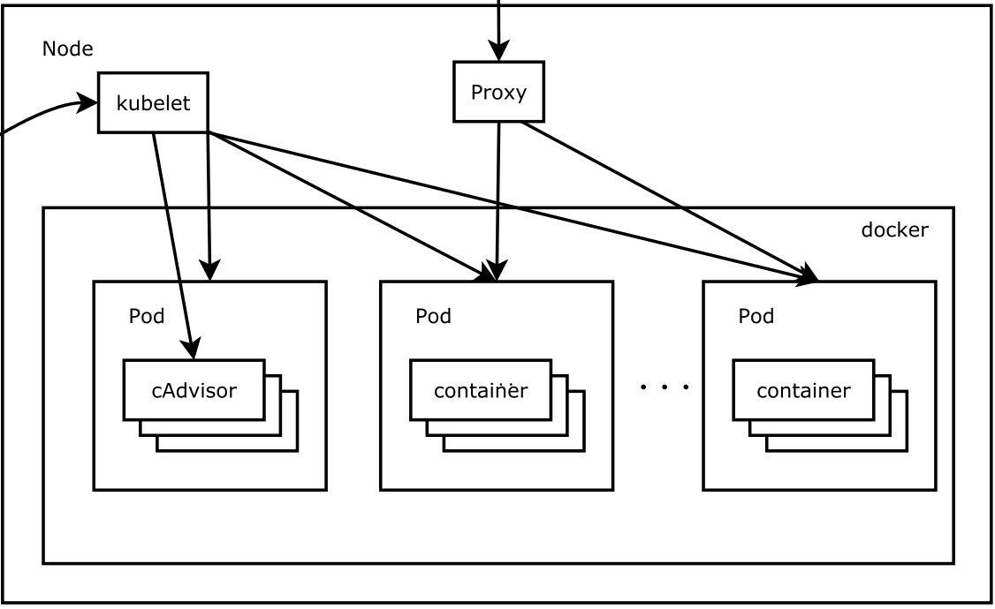
Nodes
Source: https://github.com/kubernetes/kubernetes/blob/release-1.4/docs/design/architecture.md

Slide 135
Nodes
Worker Machine
Physical or Virtual
Each node runs kubelet
Manages pods, containers, images and volumes
Each node runs kube-proxy
Simple network proxy and load balancer supporting services

Slide 136
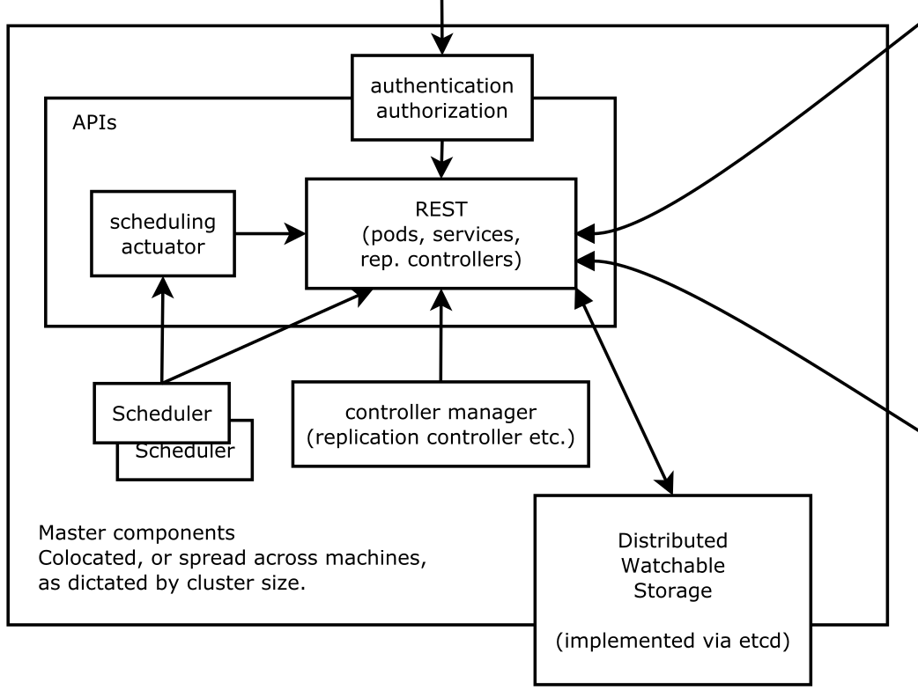
Master Node
Source: https://github.com/kubernetes/kubernetes/blob/release-1.4/docs/design/architecture.md

Slide 137
Master Node
Controls the cluster
Schedules all pods within the cluster
Not currently H/A (This is changing)
Very modular
Provides control and introspection of the cluster through REST API
Permanent master state managed by etcd
All other cluster-level functions are currently performed by the Controller Manager.
Endpoints objects are created and updated by the endpoints controller
Nodes are discovered, managed, and monitored by the node controller.
Replication Controller

Slide 138
Pod Networking
Pod IPs are routable
Docker default is private IP
Pods can reach each other without NAT
even across nodes
No brokering of port numbers
This, fundamental requirement is a lessoned learned from Borg & Omega
several SDN solutions

Slide 139
Labels
App: Nifty
Phase: Dev
Role: FE
App: Nifty
Phase: Dev
Role: BE
Arbitrary metadata
Attached to any API object
Generally represent identity
Queryable by selectors
think SQL ‘select ... where ...’
The only grouping mechanism
pods under a ReplicationController
pods in a Service
capabilities of a node (constraints)
App: Nifty
Phase: Test
Role: FE
App: Nifty
Phase: Test
Role: BE

Slide 140
Selectors
App: Nifty
Phase: Dev
Role: FE
App: Nifty
Phase: Dev
Role: BE
App: Nifty
Phase: Test
Role: FE
App: Nifty
Phase: Test
Role: BE

Slide 141
Selectors
App == Nifty
App: Nifty
Phase: Dev
Role: FE
App: Nifty
Phase: Dev
Role: BE
App: Nifty
Phase: Test
Role: FE
App: Nifty
Phase: Test
Role: BE

Slide 142
Selectors
App == Nifty
Role == FE
App: Nifty
Phase: Dev
Role: FE
App: Nifty
Phase: Dev
Role: BE
App: Nifty
Phase: Test
Role: FE
App: Nifty
Phase: Test
Role: BE

Slide 143
Selectors
App == Nifty
Role == BE
App: Nifty
Phase: Dev
Role: FE
App: Nifty
Phase: Dev
Role: BE
App: Nifty
Phase: Test
Role: FE
App: Nifty
Phase: Test
Role: BE

Slide 144
Selectors
App == Nifty
Phase == Dev
App: Nifty
Phase: Dev
Role: FE
App: Nifty
Phase: Dev
Role: BE
App: Nifty
Phase: Test
Role: FE
App: Nifty
Phase: Test
Role: BE

Slide 145
Selectors
App: Nifty
Phase: Dev
Role: FE
App: Nifty
Phase: Dev
Role: BE
App == Nifty
Phase == Test
App: Nifty
Phase: Test
Role: FE
App: Nifty
Phase: Test
Role: BE

Slide 146
Control Loops
observe
act
Drive current state -> desired state
Act independently
APIs - no shortcuts or back doors
Observed state is truth
Recurring pattern in the system
Example: ReplicationController
diff

Slide 147
Replication Controllers
Replication Controller
Name = “nifty-rc”
Selector = {“App”: “Nifty”, "Phase": "Dev", "Role": "FE"}
PodTemplate = { ... }
NumReplicas = 4

Slide 148
Replication Controllers
Replication Controller
Desired = 4
Current = 4
node 3
node 1
b0111
f0118
node 2
node 4
d9376
a1209

Slide 149
Replication Controllers
Replication Controller
Desired = 4
Current = 4
node 3
node 1
b0111
f0118
node 2
node 4
d9376
a1209

Slide 150
Replication Controllers
Replication Controller
Desired = 4
Current = 3
node 3
node 1
b0111
f0118
node 4
a1209

Slide 151
Replication Controllers
Replication Controller
Desired = 4
Current = 4
node 3
node 1
b0111
f0118
c9bad
node 4
a1209

Slide 152
Services
Client
A group of pods that act as one == Service
group == selector
Defines access policy
only “load balanced” for now
Gets a stable virtual IP and port
called the service portal
also a DNS name
VIP is captured by kube-proxy
watches the service constituency
updates when backends change
Hide complexity - ideal for non-native apps
Portal (VIP)

Slide 153
Service
Name = “nifty-svc”
Selector = {“App”: “Nifty”}
Port = 9376
ContainerPort = 8080
Portal IP is assigned
Client
Services
TCP / UDP
10.0.0.1 : 9376
iptables
DNAT
kube-proxy
apiserver
TCP / UDP
watch
10.240.1.1 : 8080
10.240.2.2 : 8080
10.240.3.3 : 8080

Slide 154
Getting Started
Kubernetes Bootcamp
https://kubernetesbootcamp.github.io/kubernetes-bootcamp/
Kubernetes 101 (User Guide)
http://kubernetes.io/docs/user-guide/walkthrough/
Kubernetes Labs
https://www.katacoda.com/courses/kubernetes
Kubernetes up and Running (Jan. 25th 2017, available for early access)
http://shop.oreilly.com/product/0636920043874.do
Kubernetes The Hard Way
https://github.com/kelseyhightower/kubernetes-the-hard-way

Slide 155
Commercial Products Supporting Kubernetes
Platforms: Red Hat OpenShift / Apcera HCOS / Engine Yard DEIS / Eldarion Gondor / WSO2 Stratos / Apprenda
CI/CD: Travis / Jenkins / TeamCity / Werker / CircleCI / Shippable …
Container Registry: AWS EC2 Container Registry / GCR / CoreOS Quay / Docker Hub …
Tracing Frameworks: GRPC / appdash / Linkerd / Hystrix …
Monitoring: Sysdig / Datadog / New Relic …
Logging: ElasticSearch / Fluentd / Flume / logstash …

Slide 156
Kubernetes Distributions
Canonical Distribution
https://jujucharms.com/canonical-kubernetes/
Techtonic
https://tectonic.com

Slide 157
Kubernetes Commercial Support
Techtonic
https://tectonic.com
Apprenda
https://apprenda.com/kubernetes-support/

Slide 158
Windows Container Support
Considered Alpha as of Kubernetes 1.5
Being developed by SIG-Windows, spearheaded by Apprenda with support by Microsoft, Google and Redhat

Slide 159
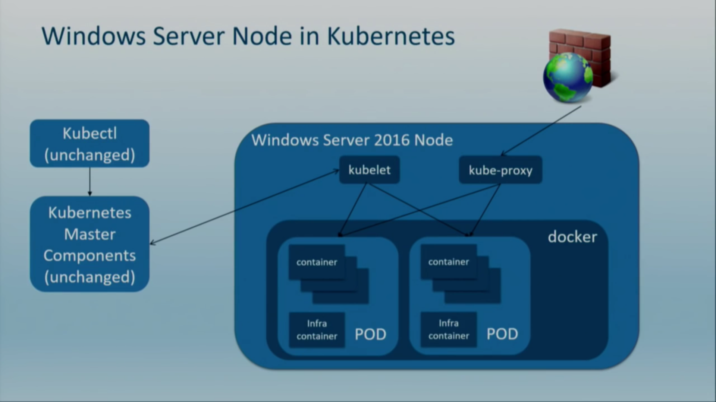
Source: Demo of Kubernetes on Windows Server by Michael Michael, Apprenda https://www.youtube.com/watch?v=Tbrckccvxwg

Slide 160
Challenges
Intra-Pod Networking
Kube-Proxy Networking

Slide 161
Intra-POD Networking
Containers cannot communicate over localhost
Each container gets its own network stack
Can’t achieve parity with Linux Pod abstraction
Linux containers can share networking stack by placing them in the same network namespace (L3 SDN supported)
Every container gets its own networking stack
No SDN plugins exist on Windows (Nothing like Calico)
Pods get an IP address that is routable across the cluster
Used Windows features like RRAS and routing table manipulation, port forwarding and packet forwarding
Source: Demo of Kubernetes on Windows Server by Michael Michael, Apprenda https://www.youtube.com/watch?v=Tbrckccvxwg

Slide 162
Kube-Proxy Networking Challenges
No iptables equivalent on Windows Server
Netsh portproxy
Does not support UDP for DNS
DNS Search not supported within the container
Relies the DNSClient to requery over tcp.
Working with MS to change.
Had to implement proxies in user space
Simple
Iptables forwards request to a local port, kube-proxy in userspace listens to the request and forwards to the appropriate backend Pod
CPU intensive
Windows Firewall updated out of band
Source: Demo of Kubernetes on Windows Server by Michael Michael, Apprenda https://www.youtube.com/watch?v=Tbrckccvxwg

